Slide 1
EE/CprE/SE 491 – Senior Design I and Professionalism
New Simulation Methods to More Effectively Integrate High Levels of Renewable Energy Resources
By: Jared Rickard, Jeremy Nash, Nidhi Rawell, Collins Ntwali
Team Number: 21
Client: MISO
Advisor: Dr. James McCalley
Team Email: sdmay20-21@iastate.edu
Team Website: http://sdmay20-21.sd.ece.iastate.edu/

Slide 2
Problem Statement
To research and implement various methods to appropriately reduce the fidelity of data profiles while maintaining an adequate amount of key production cost information.
The study must validate the methods’ reliability and quantify the effects the profile approximation has on simulation runtime and results.
It is expected that the properly designed profile reduction method would make the normal 8760 hours production cost simulation more efficient.
Final Presentation.2

Slide 3
Conceptual Sketch
Develop
Develop a software tool that computes different metrics of profile data and clusters the data into representative profiles based on those metrics.
Run
Run PCM simulations of the approximated and un-approximated data and compare the results.
Refine
Refine what metrics are used to cluster data and then run new simulations.
Document
Document what was tested to refine these metrics in a report for our client
Package
Finally package all these different options into a UI that our client can use.
Final Presentation.3

Slide 4
Functional Requirements
Python script to find approximate data sets
Data subset returned should be quantitatively "close" to original set.
Methods’ reliability
PCM simulation of this data subset must reliably forecast key PCM information of an un-approximated profile.
Total computation time
Reduce PCM simulations from ~72 hours to under 24 hours
Easy to use User-Interface
Tool design should be easy for an untrained user to test and use.
Final Presentation.4

Slide 5
Non-functional Requirements
Code Convention
Readability - Clearly commented and labelled for easy modification
Modifiability – Modularized for easy upgrades and maintenance.
Simplicity - Efficient; omit unnecessary functions
Tool Usability
Short process/steps
Fast runtime
User manual
Results
Reproducible testing
List of best metrics
Final Presentation.5

Slide 6
Potential Risks & Mitigation
Limited knowledge in coding, data manipulation, and UI design
Practice and research what works.
Limited knowledge of power grid data attributes and how to characterize the power grid.
Communicate with the client about what they would like to see
Research what others in the field might consider important
Obtaining the software necessary
Stay in constant communication with the production cost modeling software developer
Final Presentation.6

Slide 7
Resource/Cost Estimate
Resources
IDEs to write Python
Production cost modeling simulation software
Remote virtual machines to run simulation software
Cost
Python and related IDEs are free
We're receiving the simulation software for free on a research license
Virtual machines have been provided by the ETG for free
Currently zero cost
Final Presentation.7

Slide 8
Project Milestones
Complete function to subdivide data profiles
Evaluated by reviewing code and possibly hand computing test samples
Complete function that clusters data
Evaluated by reviewing code and trying simple, one-dimensional sample clusters
Run multiple PCM simulations with different approximated data sets
Evaluated by comparing to results of un-approximated data set
Complete UI
Evaluated by reviewing code and handing it off to MISO engineers to try and figure out.
Final Presentation.8

Slide 9
Functional Decomposition
Abstract mathematical instruction set to approximate data
Divide the input into subsets
Calculate attributes related to each subset
Find ideal, imaginary attributes, clustered around what was just calculated
Find the subsets who are closest to the ideal attribute sets. These are now the ideal subsets
Testing the approximated data
Calculate percent error of different attributes of approximated data in relation to original data.
Run approximated data through Production Cost Model (PCM) software
Write up results in report.
Final Presentation.9

Slide 10
Detailed Design
Input: N x A CSV set of measured generation and load
Divide the input into L x A subsets
From each of these subsets compute M attributes for each column
Organize into a N/L x A*M matrix of data, such that each row represents an LxA subset and each column is an attribute computed for each subset
x_{1,1}​ | x_{1,2}​ | …​ | x_{1,A}​
x_{2,1}​ | x_{2,2}​ | …​ | x_{2,A}​
…​ | …​ | …​ | …​
x_{N,1}​ | x_{N,2}​ | …​ | x_{N,A}​
x_{1,1}​ | x_{1,2}​ | …​ | x_{1,A}​
x_{2,1}​ | x_{2,2}​ | …​ | x_{2,A}​
…​ | …​ | …​ | …​
x_{L,1}​ | x_{L,2}​ | …​ | x_{L,A}​
…​ | …​ | …​ | …​
x_{N,1}​ | x_{N,2}​ | …​ | x_{N,A}​
L x A sized array
c_{1,1}​ | c_{1,2}​ | c_{1,3}​ | …​ | c_{1,M*A}​
c_{2,1}​ | c_{2,2}​ | c_{2,3}​ | …​ | c_{2,M*A}​
…​ | …​ | …​ | …​ | …​
c_{N/L,1}​ | c_{N/L,2}​ | c_{N/L,3}​ | …​ | c_{N/L,M*A}​
Final Presentation.10

Slide 11
Detailed Design (cont.)
Find K number of ideal, imaginary attributes, clustered around the attributes just computed
c_{1,1}​ | c_{1,2}​ | c_{1,3}​ | c_{1,4}​ | c_{1,5}​ | …​ | c_{1,M*A}​
c_{2,1}​ | c_{2,2}​ | c_{2,3}​ | c_{2,4}​ | c_{2,5}​ | …​ | c_{2,M*A}​
…​ | …​ | …​ | …​ | …​ | …​ | …​
c_{N/L,1}​ | c_{N/L,2}​ | c_{N/L,3}​ | c_{N/L,4}​ | c_{N/L,5}​ | …​ | c_{N/L,M*A}​
Detailed Design (cont.)
The clustering algorithm (currently K-Means) interprets each row as a point in M*A-dimensional space and finds K ideal points, returning these points as rows in a K x M*A matrix.
Each row of the original N/L x M*A matrix has a distance to each row of the ideal matrix and each row of the original matrix is “represented” by the closest row of the ideal matrix
Clustering algorithm
d_{1,1}​ | d_{1,2}​ | d_{1,3}​ | d_{1,4}​ | d_{1,5}​ | …​ | d_{1,M*A}​
…​ | …​ | …​ | …​ | …​ | …​ | …​
d_{K,1}​ | d_{K,2}​ | d_{K,3}​ | d_{K,4}​ | d_{K,5}​ | …​ | d_{K,M*A}​
Final Presentation.11

Slide 12
Detailed Design (cont.)
Find the subsets whose attributes are closest to these ideal attribute sets
We're unable to rebuild a full L x A array from these ideal attributes
Finally we return these ideal L x A subsets and which subsets they represent
Each L x A array is saved as a new CSV
A final CSV containing the index of every L x A subset and the index of its best representation is also saved
y_{1,1,1}​ | y_{1,2,1}​ | …​ | y_{1,A,1}​
y_{2,1,1}​ | y_{2,2,1}​ | …​ | y_{2,A,1}​
…​ | …​ | …​ | …​
y_{N,1,1}​ | y_{N,2,1}​ | …​ | y_{N,A,1}​
y_{1,1,k}​ | y_{1,2,k}​ | …​ | y_{1,A,k}​
y_{2,1,k}​ | y_{2,2,k}​ | …​ | y_{2,A,k}​
…​ | …​ | …​ | …​
y_{N,1,k}​ | y_{N,2,k}​ | …​ | y_{N,A,k}​
…
Final Presentation.12

Slide 13
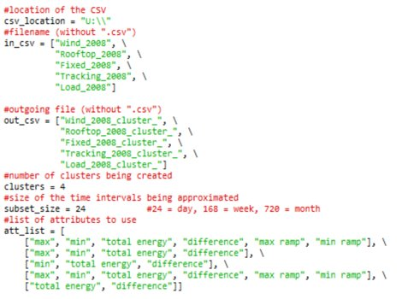
Detailed Design (cont.)
Example input settings
Example output
Final Presentation.13

Slide 14
HW/SW/Technology Platform(s) used
Software
Python for code
Plexos for production cost modeling (PCM)
Python integrated development environment (IDE)
Hardware
Virtual machines provided by the ETG to run simulations remotely
Final Presentation.14

Slide 15
Test Plan
Prior to Plexos Trials:
Runtime Tests
Variables are cluster number, attribute number, and subset size
Keep two constant, test the third
Accuracy Tests
Total energy and Cap factor
Attribute Tests
We have six attributes currently, run tests for every combination of the six
Make sure one attribute doesn't overpower other attributes
During Plexos Trials:
Runtime Tests
Make sure that simulation runtimes have been dramatically reduced
Accuracy Tests
Determine how close the results of these shortened runs compare to the original runs
Attribute Tests
Refine the attribute list based on which runs had the best accuracy from the previous test.
Final Presentation.15

Slide 16
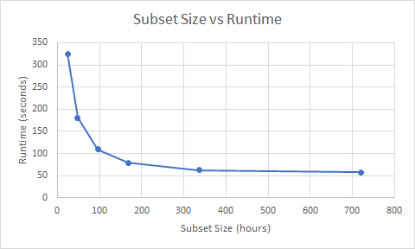
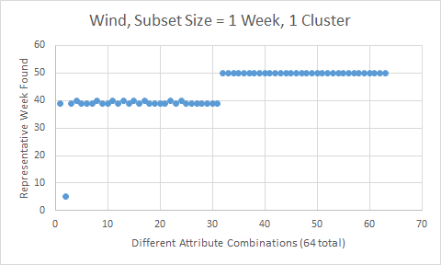
Prototype Implementations & Test Results
Prototype
Currently have a Python script that follows the basic instruction set
Limited options: small choice of attributes, only one clustering algorithm
Test Results
Examples of testing the Python code's runtime and attributes
Final Presentation.16

Slide 17
Contributions
Jared Rickard
Designed instruction set, wrote Python code around steps
Jeremy Nash
Organized client meetings and meeting notes.
Tested python code for run-time and accuracy.
Nidhi Rawell
Researched different clustering methods and various studies related to the project
Compared the pros and cons of different clustering methods
Collins Ntwali
Documented findings and progress.
Contributed to list of attributes/equations.
Final Presentation.17

Slide 18
Current Project Status
As of Monday, December 9 2019:
Initial coding is finished
Recently obtained simulation software
Some functional testing complete
Some nonfunctional testing complete
Final Presentation.18

Slide 19
Plan for next semester
Next step:
Quantify/Weight attributes of the data
Simulate the original data profile and as many approximated profiles we can generate using PLEXOS
Add more attributes and clustering algorithm options
Develop relationships between input choices and differences in results
Develop UI
Final Presentation.19

Slide 20
Thank You!
Do you have any questions?
Team: Jeremy N, Collins N, Nidhi R, Jared R.
Advisor: Dr. James McCalley
Client: Midcontinent Independent System Operator (MISO)
Email: sdmay20-21@iastate.edu
Website: sdmay20-21.sd.ece.iastate.edu

